Slide 1
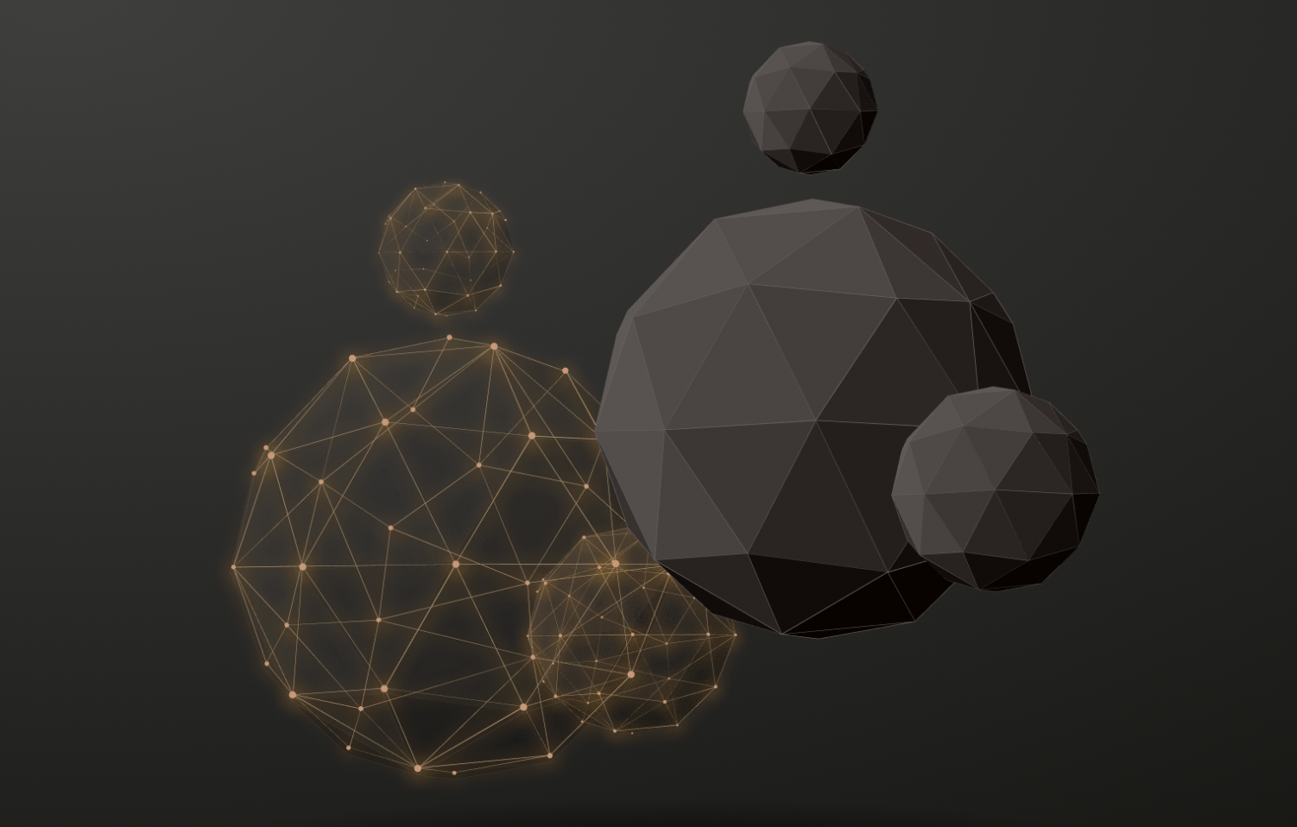
Final Briefing of Group 3 20230608
111.2_人工智慧 邱垂昱 教授 Artificial Intelligence
Using Core competencies of ChatGPT to help quickly understand articles
ChatGPT
ChatPDF
ChatDOC

Slide 2
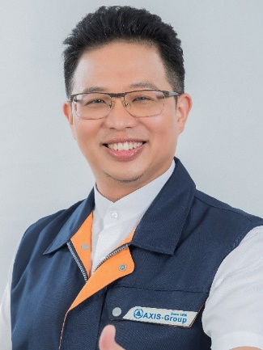
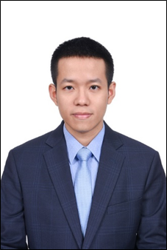
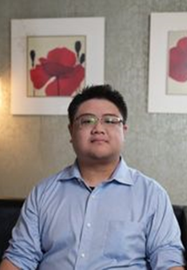
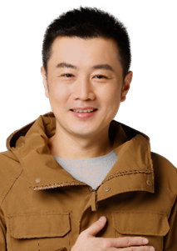
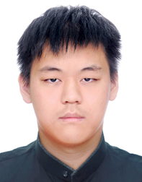

Team Members
Team member List & assignments
陳俊華 Kirin Chen | 何哲平 Ace Ho | 賴炳宏 | 張錦豪 Jing Hau Chang | 黃聿君 Yu Jyun Huang | Shirley Ngo Hong Ngoc
工管博二 | 創新碩一 | 資財碩二 | 工管博二 | 資財碩二 | 工工博三
110749018 | 111C71008 | 110AB8023 | 110749004 | 110AB8028 | 109379403
Organizer | Presenter Chapter 3 | Chapter 1 | Chapter 2 | Chapter 4 | Chapter 5

Slide 3
Index of Briefing
1. Introduction of ChatGPT
2. Three ways to use ChatGPT
3. Practical instructions
4. Advantages and disadvantages
5. Conclusion

Slide 4
1. Introduction of ChatGPT
賴炳宏

Slide 5
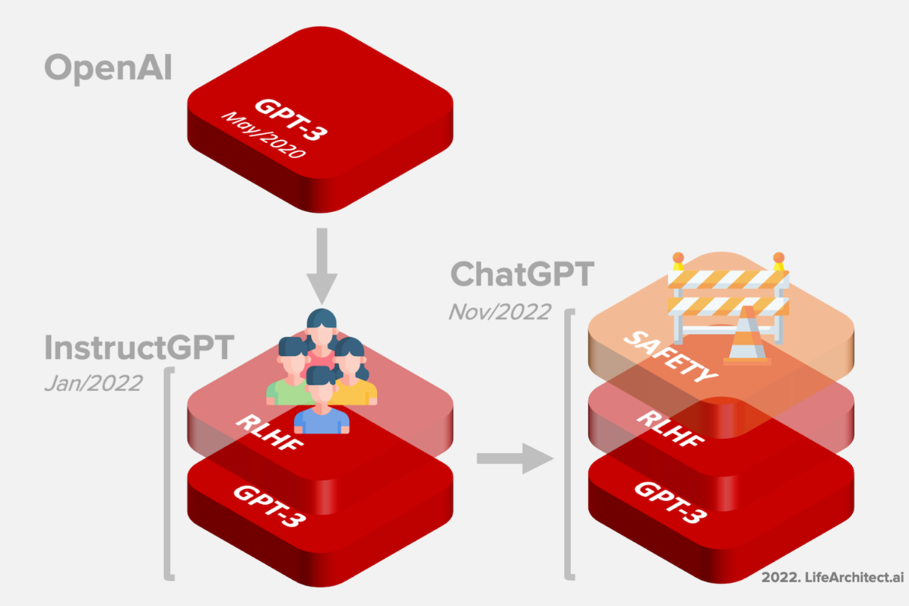
Introduction of ChatGPT
Evolution of ChatGPT
ChatGPT is a large language model developed by OpenAI based on the GPT-3.5 architecture. The first version of GPT (Generative Pre-trained Transformer) was introduced in 2015, and it has undergone continuous improvements and upgrades. GPT-3 was the latest version released in 2020, and GPT-3.5 is an upgrade built upon that, offering even better language generation and understanding capabilities.

Slide 6
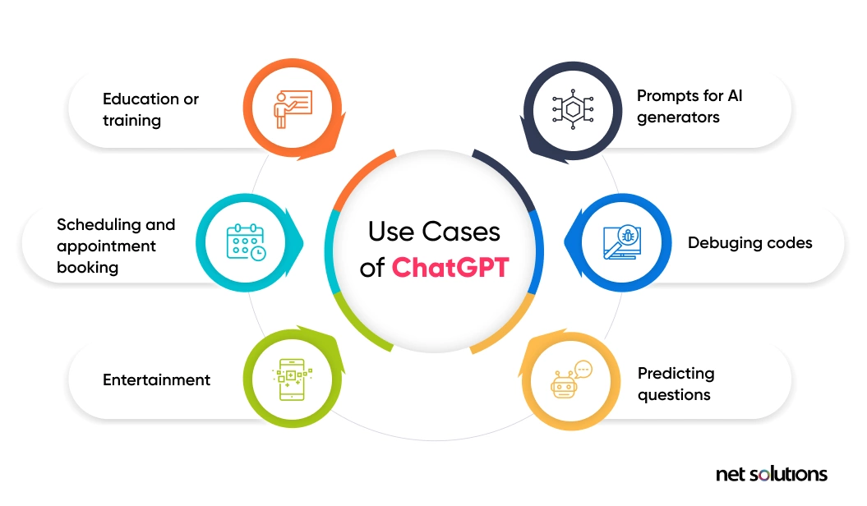
Introduction of ChatGPT
Core Values of ChatGPT
The core value of ChatGPT is its ability to engage in natural language conversations, facilitating interaction between humans and machines.
ChatGPT can understand and generate natural language, enabling context-aware dialogues.
The goal of ChatGPT is to simulate human conversational abilities, including answering questions, providing explanations, performing tasks, and engaging in meaningful conversations.
Net solutions. What is ChatGPT, and its possible use cases?
Retrieved from https://www.netsolutions.com/insights/what-is-chatgpt/

Slide 7
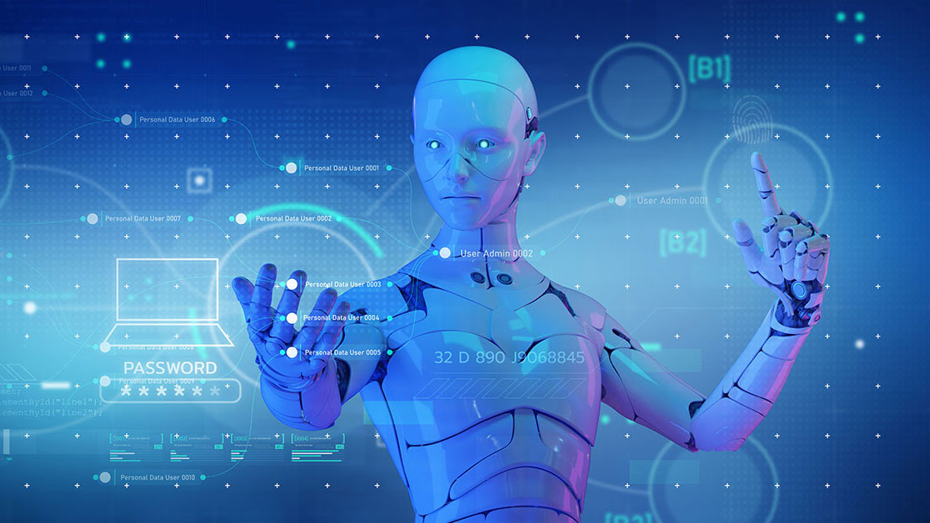
Introduction of ChatGPT
Key features of ChatGPT
Versatility: Applied in various domains and scenarios such as customer service dialogues, question-answering systems, simple task execution, etc.
Context-awareness: Remember the context of the conversation and utilize relevant information when answering questions.
Learning ability: Continuously improve its generation and understanding abilities through training with large amounts of data.
Creativity: It sometimes generates creative responses or can handle unknown questions.

Slide 8
2. Three ways to use ChatGPT
張錦豪 Jing Hau Chang

Slide 9
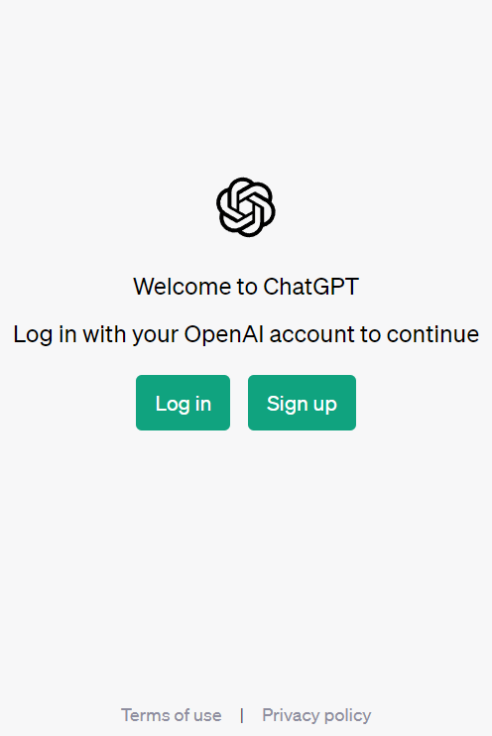
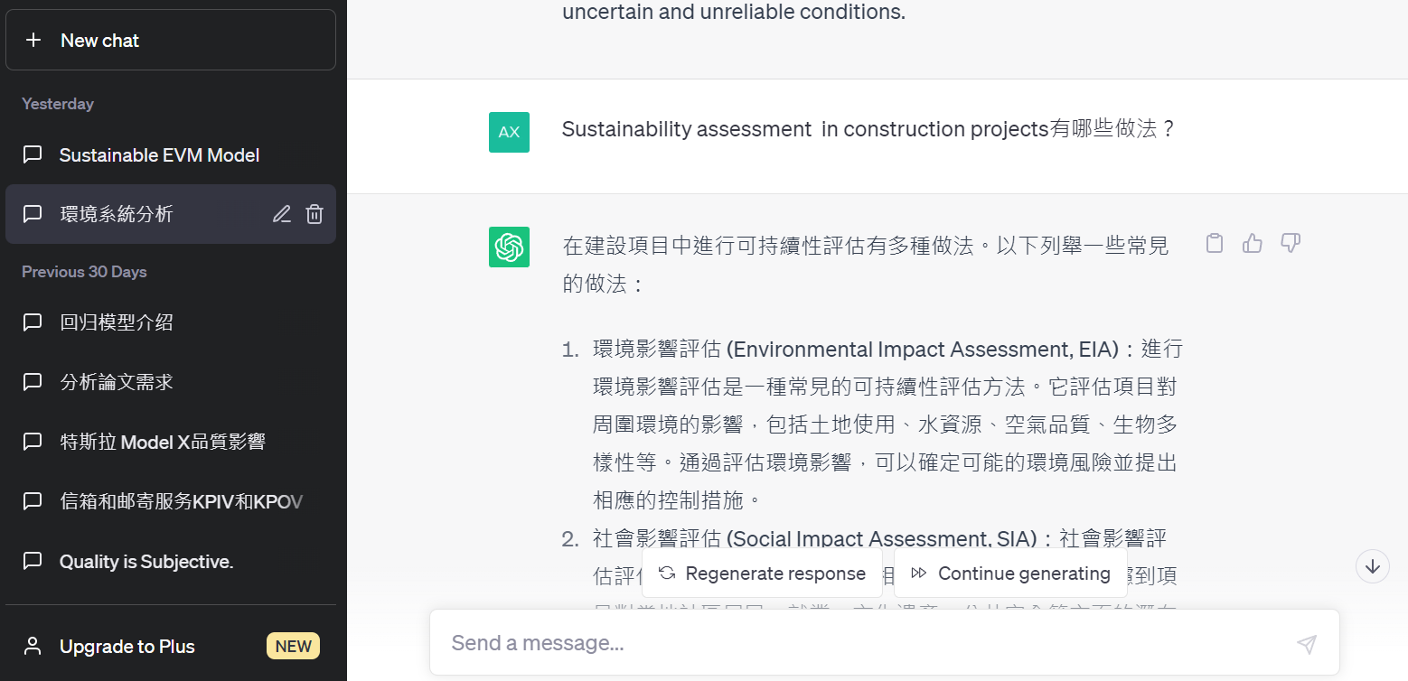
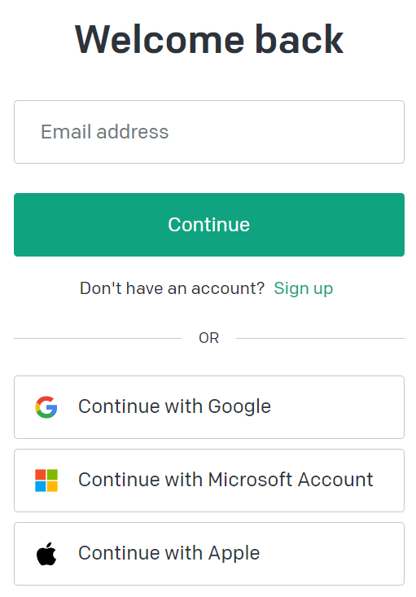
Three ways to use ChatGPT
ChatGPT
https://chat.openai.com/auth/login
Step 1：
Step 5：Need more. Send “ Go on”
Step 2：
Step 4：Send
Step 3：Send a Message

Slide 10
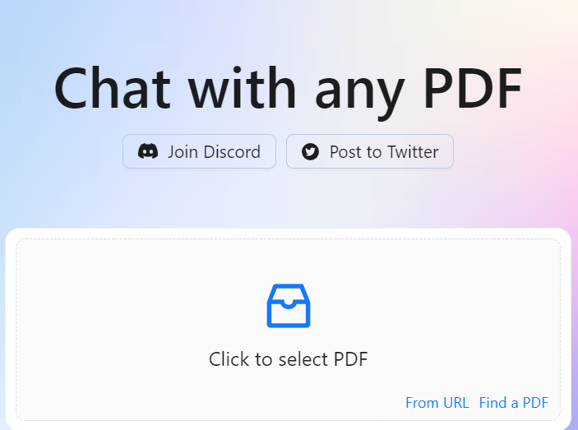
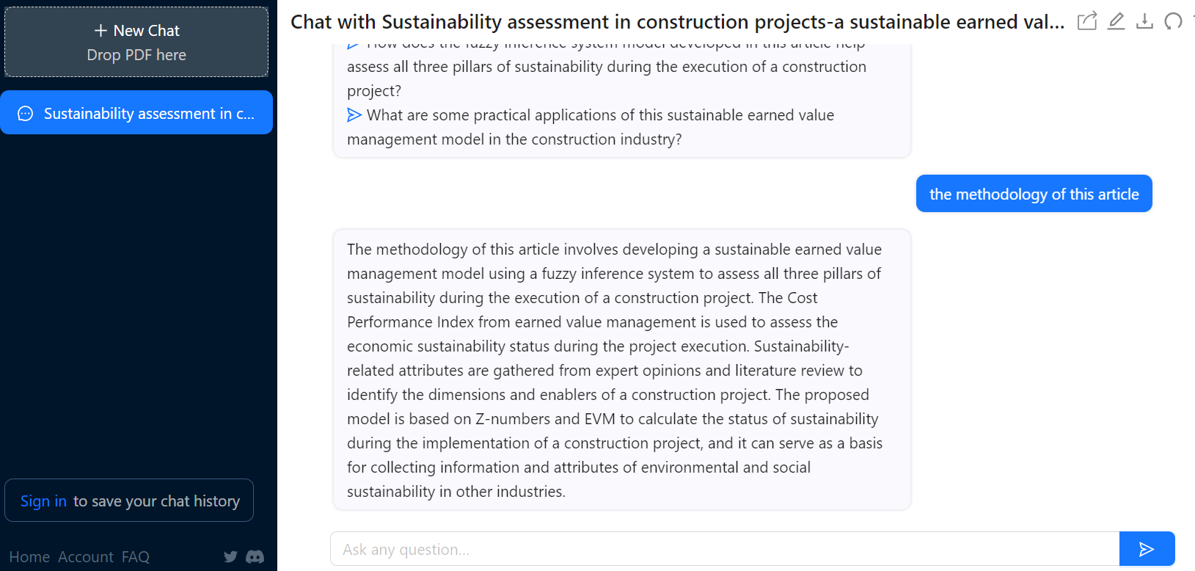
Three ways to use ChatGPT
ChatPDF
https://www.chatpdf.com/
Step 1：Upload PDF file
Step 3：Send
Step 2：Ask any question about this PDF

Slide 11
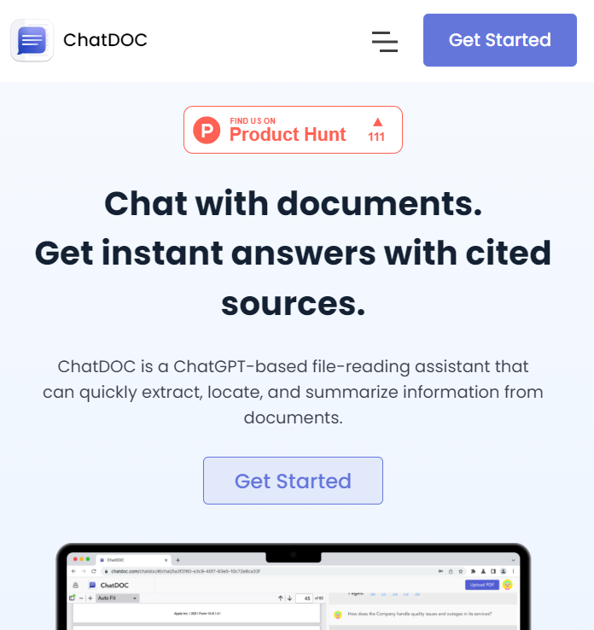
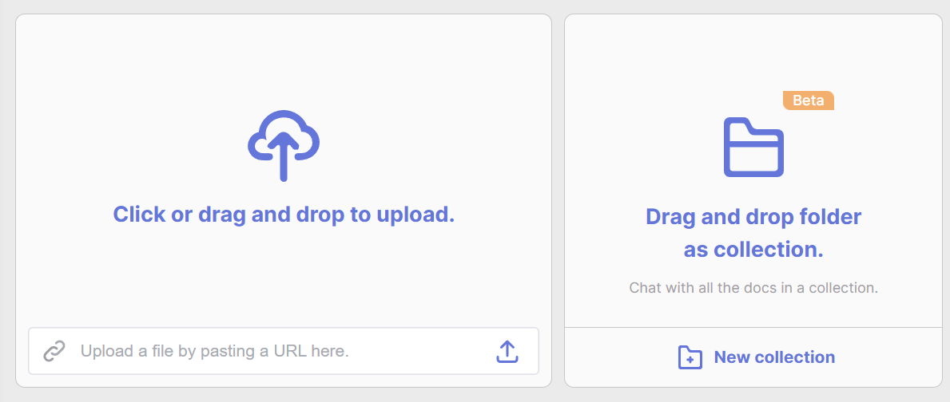
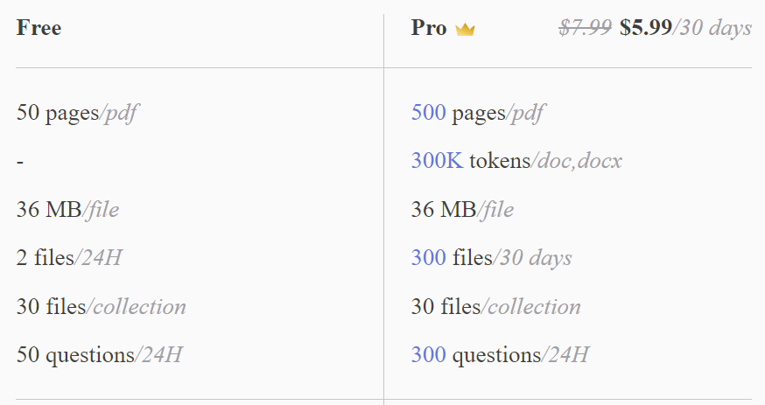
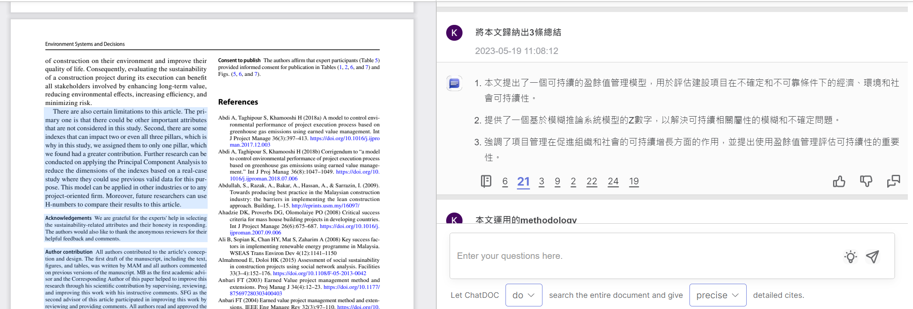
Three ways to use ChatGPT
ChatDOC
https://chatdoc.com/
Step 1：
Step 2：upload file
Step 7：Highlight of Source
Step 6：Source of this article
Step 5：Send
Step 4：Enter your Question
Step 3：Setup

Slide 12
3. Practical instructions
何哲平 Ace Ho

Slide 13
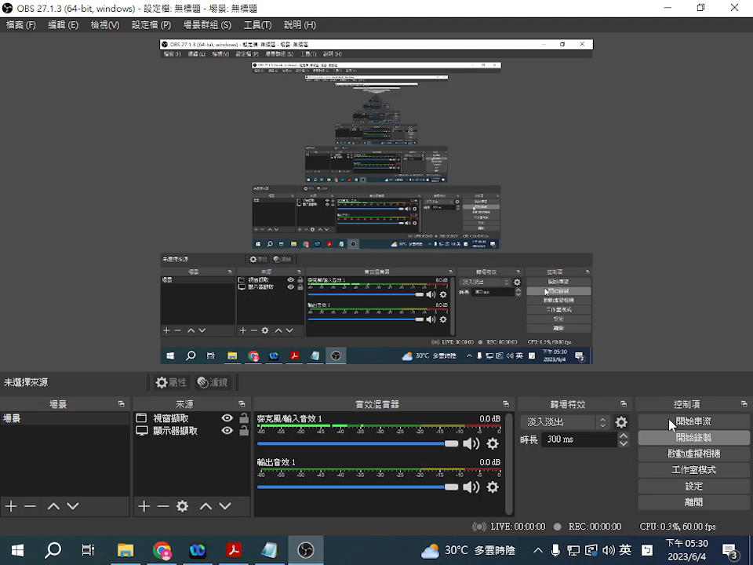
Practical instructions (ChatGPT)

Slide 14

Practical instructions (ChatPDF)

Slide 15
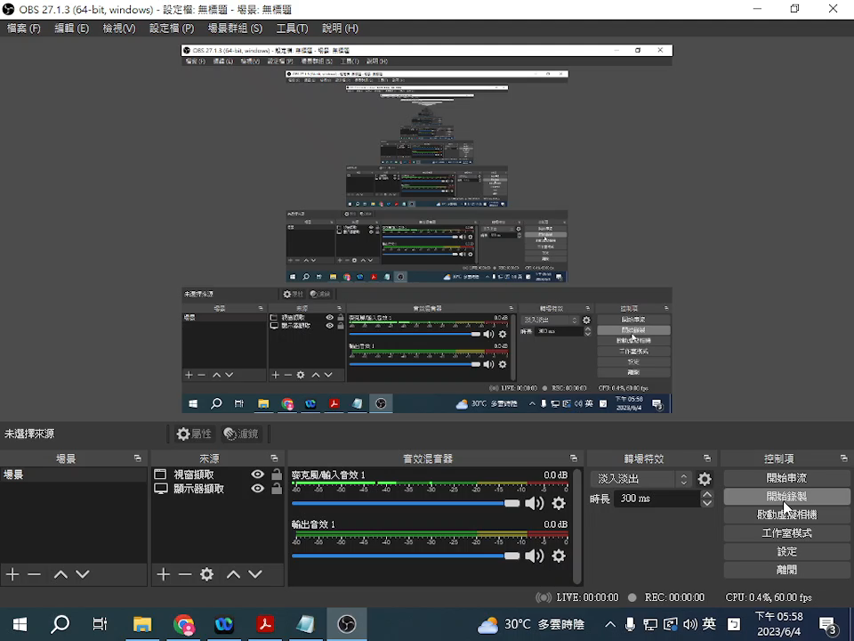
Practical instructions (ChatDOC)

Slide 16
4. Advantages and disadvantages
黃聿君
Yu Jyun Huang

Slide 17
Advantages and disadvantages
Advantages
ChatGPT
Free-form conversation: ChatGPT can engage in free-form dialogue and answer a wide range of questions.
PDF document processing: ChatPDF is designed for handling PDF documents, It can extracting text, parsing structures, and answering PDF-related questions.
ChatPDF
Sources cited for fact checking : ChatDOC's responses are backed by direct citations extracted from the files. You can click and check to ensure the accuracy of AI interpretation.
ChatDoc
Query across multiple files at once : ChatDOC can consolidate the answers in multiple documents, you can acquire knowledge effortlessly through conversation.
Select tables / texts to get explanations : ChatDOC allows you to select a specific section of content from the original file, and ask targeted questions, get more accurate answers.

Slide 18
Advantages and disadvantages
Disadvantages
Potential for uncertain answers: Since ChatGPT's responses are based on statistical probabilities in its training data, it may sometimes provide uncertain or inaccurate answers.
ChatGPT
Unable to processing document : ChatGPT does not have the capability to upload and process PDF files.
Disadvantages compared to ChatDoc:
ChatPDF does not show the source of the answers and you can’t verify the accuracy of the responses.
You cannot interact with the original file in ChatPDF, it only presents a chat room interface.
ChatPDF
Format compatibility: same as ChatPDF, it may encounter issues with certain complex or special format PDF files. This may include inaccurate display of special fonts, images, or layout elements, or an inability to properly interpret and handle specific PDF functionalities.
ChatDoc

Slide 19
5. Other applications and future developments
Shirley Ngo Hong Ngoc

Slide 20
Conclusion
FUTURE DEVELOPMENTS
Enhanced Accuracy: Continual training and fine-tuning of ChatGPT using larger and more diverse datasets can help improve its accuracy and reduce instances of generating inaccurate or misleading information.
Contextual Understanding: Further advancements in natural language processing models can enable ChatGPT to better understand and contextualize complex queries, enhancing its ability to provide more accurate and relevant responses.
Multilingual Support: Expanding ChatGPT's language capabilities to include more languages can enable a wider range of users to benefit from its assistance in understanding and generating content in their preferred language.
Ethical Guidelines: Establishing clear guidelines and standards for the ethical use of ChatGPT, including guidelines for researchers, developers, and users, can ensure responsible deployment and prevent misuse of the technology.

Slide 21
Conclusion
CONCLUSION
ChatGPT's core competencies offer researchers valuable support in rapidly understanding scientific research articles. By utilizing its natural language understanding, summarization, terminology clarification, and conceptual explanation capabilities, researchers can enhance their comprehension, save time, and foster more efficient scientific inquiry.
However, this AI tool also presents few limitations, which suggests direction to future improvements. Specifically, as a text-based AI model, ChatGPT can’t directly handle document files or pictures as inputs.
With continued advancements in natural language processing and machine learning, there is still room for ChatGPT to improve its capabilities and expand its applications in the future.

Slide 22


